Slide 1

CLASS 41 CD-404 REGRESSION AND ITS TYPES UNIT 4
REGRESSION AND ITS TYPES
Prof. Vineeta Shrivastava
Assistant Professor
Department of Computer Science & Engineering
LNCT-E, Bhopal
Lakshmi Narain College of Technology Excellence, Bhopal

Slide 2
CLASS 41 CD-404 REGRESSION AND ITS TYPES UNIT 4
AGENDA
What is Regression ?
What is Regression Analysis ?
What is the purpose of using Regression Analysis?
What are the types of Regression ?
Prof. Vineeta Shrivastava
Assistant Professor
Department of Computer Science & Engineering
LNCT-E, Bhopal
Lakshmi Narain College of Technology Excellence, Bhopal

Slide 3
CLASS 41 CD-404 REGRESSION AND ITS TYPES UNIT 4
What is Regression ?
Regression is a statistical method that helps us understand and predict the relationship between variables.
Describes how one variable (dependent variable) changes as another variable (independent variable) changes.
It's commonly used for prediction and forecasting in various fields, including economics, finance, biology, and engineering
Prof. Vineeta Shrivastava
Assistant Professor
Department of Computer Science & Engineering
LNCT-E, Bhopal
Lakshmi Narain College of Technology Excellence, Bhopal

Slide 4
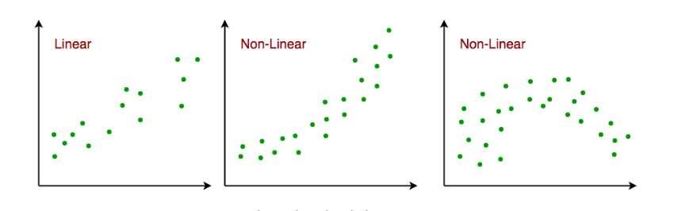
CLASS 41 CD-404 REGRESSION AND ITS TYPES UNIT 4
Prof. Vineeta Shrivastava
Assistant Professor
Department of Computer Science & Engineering
LNCT-E, Bhopal
Lakshmi Narain College of Technology Excellence, Bhopal

Slide 5
CLASS 41 CD-404 REGRESSION AND ITS TYPES UNIT 4
Dependent variable: We are trying to predict or explain (Y)
Independent variable: That are used to predict or explain the changes in dependent variable (X).
For example : predict salary on the bases of experience, predict exam score based on study hours, predict vehicle resale price based on vehicle age.
It predicts the continuous output variables based on the independent input variable. like the prediction of house prices based on different parameters like house age, distance from the main road, location, area, etc.
Prof. Vineeta Shrivastava
Assistant Professor
Department of Computer Science & Engineering
LNCT-E, Bhopal
Lakshmi Narain College of Technology Excellence, Bhopal

Slide 6
CLASS 41 CD-404 REGRESSION AND ITS TYPES UNIT 4
What is Regression Analysis ?
Regression Analysis is a statistical process for estimating the relationships between the dependent variables and one or more independent variables or predictors.
Regression analysis is generally used when we deal with a dataset that has the target variable in the form of continuous data.
Prof. Vineeta Shrivastava
Assistant Professor
Department of Computer Science & Engineering
LNCT-E, Bhopal
Lakshmi Narain College of Technology Excellence, Bhopal

Slide 7
CLASS 41 CD-404 REGRESSION AND ITS TYPES UNIT 4
Regression analysis explains the changes in criteria about changes in select predictors.
The conditional expectation of the criteria is based on predictors, where the average value of the dependent variables is given when the independent variables are changed.
Three major uses for regression analysis are determining the strength of predictors, forecasting an effect, and trend forecasting.
Prof. Vineeta Shrivastava
Assistant Professor
Department of Computer Science & Engineering
LNCT-E, Bhopal
Lakshmi Narain College of Technology Excellence, Bhopal

Slide 8
CLASS 41 CD-404 REGRESSION AND ITS TYPES UNIT 4
What is the purpose of using Regression Analysis?
Regression analysis is heavily based on statistics and hence gives quite reliable results to this reason only regression models are used to find the linear as well as non-linear relation between the independent and the dependent or target variables.
Prof. Vineeta Shrivastava
Assistant Professor
Department of Computer Science & Engineering
LNCT-E, Bhopal
Lakshmi Narain College of Technology Excellence, Bhopal

Slide 9
CLASS 41 CD-404 REGRESSION AND ITS TYPES UNIT 4
Types of Regression Techniques
Along with the development of the machine learning domain regression analysis techniques have gained popularity as well as developed manifold from just y = mx + c.
There are several types of regression techniques, each suited for different types of data and different types of relationships.
Prof. Vineeta Shrivastava
Assistant Professor
Department of Computer Science & Engineering
LNCT-E, Bhopal
Lakshmi Narain College of Technology Excellence, Bhopal

Slide 10
CLASS 41 CD-404 REGRESSION AND ITS TYPES UNIT 4
The main types of regression techniques are:
Linear Regression (Simple and Multiple Regression)
Non-Linear Regression
Polynomial Regression
Ridge Regression
Lasso Regression
Prof. Vineeta Shrivastava
Assistant Professor
Department of Computer Science & Engineering
LNCT-E, Bhopal
Lakshmi Narain College of Technology Excellence, Bhopal

Slide 11
CLASS 41 CD-404 REGRESSION AND ITS TYPES UNIT 4
Linear Regression
Linear regression is a type of supervised machine learning algorithm that computes the linear relationship between the dependent variable and one or more independent features by fitting a linear equation to observed data.
When there is only one independent feature, it is known as Simple Linear Regression, and when there are more than one feature, it is known as Multiple Linear Regression.
Prof. Vineeta Shrivastava
Assistant Professor
Department of Computer Science & Engineering
LNCT-E, Bhopal
Lakshmi Narain College of Technology Excellence, Bhopal

Slide 12
CLASS 41 CD-404 REGRESSION AND ITS TYPES UNIT 4
Similarly, when there is only one dependent variable, it is considered Univariate Linear Regression, while when there are more than one dependent variables, it is known as Multivariate Regression.
Prof. Vineeta Shrivastava
Assistant Professor
Department of Computer Science & Engineering
LNCT-E, Bhopal
Lakshmi Narain College of Technology Excellence, Bhopal

Slide 13
CLASS 41 CD-404 REGRESSION AND ITS TYPES UNIT 4
Simple linear regression
Simple linear regression is used to estimate the relationship between two quantitative variables.
Uses when we want to know: How strong the relationship is between two variables (e.g., the relationship between rainfall and soil erosion).
Prof. Vineeta Shrivastava
Assistant Professor
Department of Computer Science & Engineering
LNCT-E, Bhopal
Lakshmi Narain College of Technology Excellence, Bhopal

Slide 14
CLASS 41 CD-404 REGRESSION AND ITS TYPES UNIT 4
This is the simplest form of linear regression, and it involves only one independent variable and one dependent variable. The equation for simple linear regression is:
Y=β₀​+β₁​X
where:
Y is the dependent variable
X is the independent variable
β0 is the intercept
β1 is the slope
Prof. Vineeta Shrivastava
Assistant Professor
Department of Computer Science & Engineering
LNCT-E, Bhopal
Lakshmi Narain College of Technology Excellence, Bhopal

Slide 15
CLASS 41 CD-404 REGRESSION AND ITS TYPES UNIT 4
Multiple Linear regression
Multiple regression is a statistical technique that can be used to analyze the relationship between a single dependent variable and several independent variables.
The objective of multiple regression analysis is to use the independent variables whose values are known to predict the value of the single dependent value.
Prof. Vineeta Shrivastava
Assistant Professor
Department of Computer Science & Engineering
LNCT-E, Bhopal
Lakshmi Narain College of Technology Excellence, Bhopal

Slide 16
CLASS 41 CD-404 REGRESSION AND ITS TYPES UNIT 4
This involves more than one independent variable and one dependent variable. The equation for multiple linear regression is:
Y=β₀​+β₁​X₁+β₂​X₂+………β_{n}​X_{n}
where:
Y is the dependent variable
X1, X2, …, Xn are the independent variables
β0 is the intercept
β1, β2, …, βn are the slopes
Prof. Vineeta Shrivastava
Assistant Professor
Department of Computer Science & Engineering
LNCT-E, Bhopal
Lakshmi Narain College of Technology Excellence, Bhopal

Slide 17
CLASS 41 CD-404 REGRESSION AND ITS TYPES UNIT 4
Non-Linear Regression
Nonlinear regression refers to a broader category of regression models where the relationship between the dependent variable and the independent variables is not assumed to be linear.
If the underlying pattern in the data exhibits a curve, whether it’s exponential growth, logarithmic, or any other non-linear form, fitting a nonlinear regression model can provide a more accurate representation of the relationship.
Prof. Vineeta Shrivastava
Assistant Professor
Department of Computer Science & Engineering
LNCT-E, Bhopal
Lakshmi Narain College of Technology Excellence, Bhopal

Slide 18

CLASS 41 CD-404 REGRESSION AND ITS TYPES UNIT 4
A nonlinear regression model can be expressed as
$$Y=f\left(X,β\right)+∈$$
Where: $f\left(X,β\right)$Regression function
X: This is the vector of independent variables, which are used to predict the dependent variable.
$β$:The vector of parameters that the model aims to estimate.
$∈$:error term
Prof. Vineeta Shrivastava
Assistant Professor
Department of Computer Science & Engineering
LNCT-E, Bhopal
Lakshmi Narain College of Technology Excellence, Bhopal

Slide 19
CLASS 41 CD-404 REGRESSION AND ITS TYPES UNIT 4
Polynomial Regression
Polynomial Regression is a regression algorithm that models the relationship between a dependent(y) and independent variable(x) as n_{th} degree polynomial.
y= b₀+b₁x₁+ b₂x₁²+ b₂x₁³+...... b_{n}x₁^{n}
Prof. Vineeta Shrivastava
Assistant Professor
Department of Computer Science & Engineering
LNCT-E, Bhopal
Lakshmi Narain College of Technology Excellence, Bhopal

Slide 20
CLASS 41 CD-404 REGRESSION AND ITS TYPES UNIT 4
It is also called the special case of Multiple Linear Regression in ML. Because we add some polynomial terms to the Multiple Linear regression equation to convert it into Polynomial Regression.
It is a linear model with some modification in order to increase the accuracy.
The dataset used in Polynomial regression for training is of non-linear nature.
It makes use of a linear regression model to fit the complicated and non-linear functions and datasets.
Prof. Vineeta Shrivastava
Assistant Professor
Department of Computer Science & Engineering
LNCT-E, Bhopal
Lakshmi Narain College of Technology Excellence, Bhopal

Slide 21
CLASS 41 CD-404 REGRESSION AND ITS TYPES UNIT 4
Hence, "In Polynomial regression, the original features are converted into Polynomial features of required degree (2,3,..,n) and then modeled using a linear model."
Prof. Vineeta Shrivastava
Assistant Professor
Department of Computer Science & Engineering
LNCT-E, Bhopal
Lakshmi Narain College of Technology Excellence, Bhopal

Slide 22
CLASS 41 CD-404 REGRESSION AND ITS TYPES UNIT 4
Need for Polynomial Regression:
If we apply a linear model on a linear dataset, then it provides us a good result as we have seen in Simple Linear Regression, but if we apply the same model without any modification on a non-linear dataset, then it will produce a drastic output. Due to which loss function will increase, the error rate will be high, and accuracy will be decreased.
Prof. Vineeta Shrivastava
Assistant Professor
Department of Computer Science & Engineering
LNCT-E, Bhopal
Lakshmi Narain College of Technology Excellence, Bhopal

Slide 23
CLASS 41 CD-404 REGRESSION AND ITS TYPES UNIT 4
So for such cases, where data points are arranged in a non-linear fashion, we need the Polynomial Regression model. We can understand it in a better way using the below comparison diagram of the linear dataset and non-linear dataset.
Prof. Vineeta Shrivastava
Assistant Professor
Department of Computer Science & Engineering
LNCT-E, Bhopal
Lakshmi Narain College of Technology Excellence, Bhopal

Slide 24
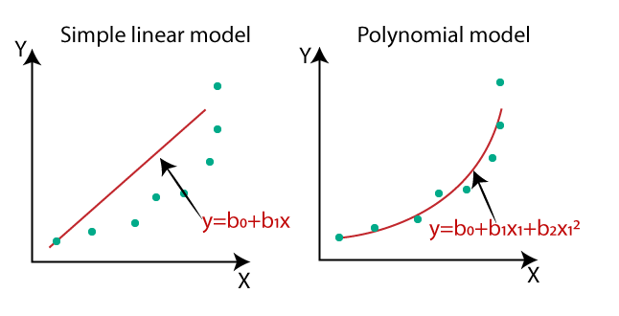
CLASS 41 CD-404 REGRESSION AND ITS TYPES UNIT 4
In the below image, we have taken a dataset which is arranged non-linearly. So if we try to cover it with a linear model, then we can clearly see that it hardly covers any data point. On the other hand, a curve is suitable to cover most of the data points, which is of the Polynomial model.
Prof. Vineeta Shrivastava
Assistant Professor
Department of Computer Science & Engineering
LNCT-E, Bhopal
Lakshmi Narain College of Technology Excellence, Bhopal

Slide 25
CLASS 41 CD-404 REGRESSION AND ITS TYPES UNIT 4
Hence, if the datasets are arranged in a non-linear fashion, then we should use the Polynomial Regression model instead of Simple Linear Regression
Prof. Vineeta Shrivastava
Assistant Professor
Department of Computer Science & Engineering
LNCT-E, Bhopal
Lakshmi Narain College of Technology Excellence, Bhopal

Slide 26
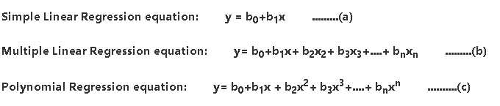
CLASS 41 CD-404 REGRESSION AND ITS TYPES UNIT 4
Equation of the Polynomial Regression Model:
Prof. Vineeta Shrivastava
Assistant Professor
Department of Computer Science & Engineering
LNCT-E, Bhopal
Lakshmi Narain College of Technology Excellence, Bhopal

Slide 27
CLASS 41 CD-404 REGRESSION AND ITS TYPES UNIT 4
Ridge Regression
Ridge Regression: This is a type of linear regression that includes a regularization term (L2 norm) in the loss function.
It helps prevent overfitting by penalizing large coefficients.
Lasso Regression
Lasso Regression: Similar to ridge regression, lasso regression also includes a regularization term (L1 norm) in the loss function. It tends to produce sparse models by driving some coefficients to zero.
Prof. Vineeta Shrivastava
Assistant Professor
Department of Computer Science & Engineering
LNCT-E, Bhopal
Lakshmi Narain College of Technology Excellence, Bhopal

Slide 28
CLASS 41 CD-404 REGRESSION AND ITS TYPES UNIT 4
Model Evaluation using Visualization
Model evaluation in machine learning involves assessing the performance of a trained model using various metrics and visualizations.
For classification models, common metrics include accuracy, precision, recall, F1 score, and ROC-AUC, often visualized through confusion matrices and ROC curves.
Prof. Vineeta Shrivastava
Assistant Professor
Department of Computer Science & Engineering
LNCT-E, Bhopal
Lakshmi Narain College of Technology Excellence, Bhopal

Slide 29
CLASS 41 CD-404 REGRESSION AND ITS TYPES UNIT 4
For regression models, metrics like Mean Absolute Error (MAE), Mean Squared Error (MSE), and R-squared (R²) are used, with residual plots aiding in diagnosis.
Visualizations such as learning curves help understand overfitting and underfitting, while feature importance plots provide insights into model decision-making. Effective evaluation ensures the model's reliability and guides further tuning or model selection.
Prof. Vineeta Shrivastava
Assistant Professor
Department of Computer Science & Engineering
LNCT-E, Bhopal
Lakshmi Narain College of Technology Excellence, Bhopal

Slide 30
CLASS 41 CD-404 REGRESSION AND ITS TYPES UNIT 4
Model evaluation using visualization is a powerful technique to gain insights into the performance of machine learning models.
Visualization Methods
Confusion Matrix:
ROC Curve:
Precision-Recall Curve:
Residual Plot:
Distribution Plot:
Prof. Vineeta Shrivastava
Assistant Professor
Department of Computer Science & Engineering
LNCT-E, Bhopal
Lakshmi Narain College of Technology Excellence, Bhopal

Slide 31
CLASS 41 CD-404 REGRESSION AND ITS TYPES UNIT 4
Confusion Matrix:
A confusion matrix is a tabular representation of actual vs. predicted values. It's commonly used for evaluating classification models.
Visualizing a confusion matrix can help you understand where your model is making errors, such as false positives and false negatives.
Prof. Vineeta Shrivastava
Assistant Professor
Department of Computer Science & Engineering
LNCT-E, Bhopal
Lakshmi Narain College of Technology Excellence, Bhopal

Slide 32
CLASS 41 CD-404 REGRESSION AND ITS TYPES UNIT 4
ROC Curve:
The Receiver Operating Characteristic (ROC) curve is used to evaluate the performance of binary classification models.
It plots the true positive rate (sensitivity) against the false positive rate (1 - specificity) at various threshold settings.
AUC (Area Under the Curve) is often calculated to quantify the performance, where a higher AUC indicates better model performance.
Prof. Vineeta Shrivastava
Assistant Professor
Department of Computer Science & Engineering
LNCT-E, Bhopal
Lakshmi Narain College of Technology Excellence, Bhopal

Slide 33
CLASS 41 CD-404 REGRESSION AND ITS TYPES UNIT 4
Precision-Recall Curve:
This curve is another way to evaluate binary classification models, especially when dealing with imbalanced datasets.
It plots precision (positive predictive value) against recall (sensitivity) at different threshold settings.
A higher area under the precision-recall curve indicates better model performance
Prof. Vineeta Shrivastava
Assistant Professor
Department of Computer Science & Engineering
LNCT-E, Bhopal
Lakshmi Narain College of Technology Excellence, Bhopal

Slide 34
CLASS 41 CD-404 REGRESSION AND ITS TYPES UNIT 4
Residual Plot:
For regression models, a residual plot shows the difference between observed and predicted values (residuals) against the independent variable(s).
It's useful for checking if the model's assumptions are meet and for identifying patterns in residuals.
Prof. Vineeta Shrivastava
Assistant Professor
Department of Computer Science & Engineering
LNCT-E, Bhopal
Lakshmi Narain College of Technology Excellence, Bhopal

Slide 35
CLASS 41 CD-404 REGRESSION AND ITS TYPES UNIT 4
A residual plot is a graphical representation used in regression analysis to assess the goodness of fit of a model.
It plots the residuals, which are the differences between the observed values and the predicted values by the model, on the y-axis against the predicted values or the independent variable on the x-axis.
Prof. Vineeta Shrivastava
Assistant Professor
Department of Computer Science & Engineering
LNCT-E, Bhopal
Lakshmi Narain College of Technology Excellence, Bhopal

Slide 36
CLASS 41 CD-404 REGRESSION AND ITS TYPES UNIT 4
Some common types of residual plots used in model visualization
Scatter plot
Bubble chart
Prof. Vineeta Shrivastava
Assistant Professor
Department of Computer Science & Engineering
LNCT-E, Bhopal
Lakshmi Narain College of Technology Excellence, Bhopal

Slide 37
CLASS 41 CD-404 REGRESSION AND ITS TYPES UNIT 4
Benefits of residual plot
Model Validation: Helps in validating whether the assumptions of the regression model are met.
Model Improvement: Provides insights into how the model can be improved by suggesting transformations of variables, inclusion of additional variables, or use of different modeling techniques.
Identifying Issues: Aids in identifying issues like outliers, non-linearity, and heteroscedasticity, which can be addressed to enhance model performance
Prof. Vineeta Shrivastava
Assistant Professor
Department of Computer Science & Engineering
LNCT-E, Bhopal
Lakshmi Narain College of Technology Excellence, Bhopal

Slide 38
CLASS 41 CD-404 REGRESSION AND ITS TYPES UNIT 4
Distributed plot
A distributed plot, often referred to as a distribution plot, is used in model visualization to understand the distribution of data or model predictions.
This type of plot helps in assessing whether the data follows a specific distribution and identifying patterns, outliers, or anomalies.
Prof. Vineeta Shrivastava
Assistant Professor
Department of Computer Science & Engineering
LNCT-E, Bhopal
Lakshmi Narain College of Technology Excellence, Bhopal

Slide 39
CLASS 41 CD-404 REGRESSION AND ITS TYPES UNIT 4
Some common types of distribution plots used in model visualization
Histogram
Box Plot
Bar Graph
Prof. Vineeta Shrivastava
Assistant Professor
Department of Computer Science & Engineering
LNCT-E, Bhopal
Lakshmi Narain College of Technology Excellence, Bhopal

Slide 40
CLASS 41 CD-404 REGRESSION AND ITS TYPES UNIT 4
In model visualization, distribution plots can be used to
Compare the distribution of actual vs. predicted values: This helps in understanding how well the model captures the underlying distribution of the data.
Visualize residuals:Plotting the distribution of residuals (the differences between actual and predicted values) helps in diagnosing model performance and identifying any systematic errors.
Assess feature distribution: Understanding the distribution of input features can help in feature engineering and preprocessing steps
Prof. Vineeta Shrivastava
Assistant Professor
Department of Computer Science & Engineering
LNCT-E, Bhopal
Lakshmi Narain College of Technology Excellence, Bhopal

Slide 41
CLASS 41 CD-404 REGRESSION AND ITS TYPES UNIT 4
Polynomial Regression and Pipelines
Polynomial Regression is a form of linear regression in which the relationship between the independent variable xxx and the dependent variable (y) is modeled as an nth degree polynomial.
It allows for the modeling of non-linear relationships by introducing polynomial terms into the regression equation
Prof. Vineeta Shrivastava
Assistant Professor
Department of Computer Science & Engineering
LNCT-E, Bhopal
Lakshmi Narain College of Technology Excellence, Bhopal

Slide 42
CLASS 41 CD-404 REGRESSION AND ITS TYPES UNIT 4
Polynomial Regression Equation
y=β₀​+β₁​x+β₂​x²+β₃​x³+…+β_{n}​x^{n}+ϵ
Here, β₀,β₁,β₂,…,β_{n} are the coefficients of the polynomial terms, and ϵ\epsilonϵ is the error term
Steps to Implement Polynomial Regression
Transform the Data: Convert the original features into polynomial features
Fit the Model: Use linear regression to fit the transformed features.
Predict: Use the fitted model to make predictions on new data
Prof. Vineeta Shrivastava
Assistant Professor
Department of Computer Science & Engineering
LNCT-E, Bhopal
Lakshmi Narain College of Technology Excellence, Bhopal

Slide 43
CLASS 41 CD-404 REGRESSION AND ITS TYPES UNIT 4
Pipelines
In machine learning, a pipeline is a tool that helps automate the workflow of creating and training models.
Pipelines are especially useful for sequentially applying a series of transformations and a final estimator
Prof. Vineeta Shrivastava
Assistant Professor
Department of Computer Science & Engineering
LNCT-E, Bhopal
Lakshmi Narain College of Technology Excellence, Bhopal

Slide 44
CLASS 41 CD-404 REGRESSION AND ITS TYPES UNIT 4
Benefits of Pipelines:
Automation: Automates the process of transforming data and fitting models.
Efficiency: Streamlines the workflow, making the process more efficient.
Reproducibility: Ensures that the same steps are applied consistently
Prof. Vineeta Shrivastava
Assistant Professor
Department of Computer Science & Engineering
LNCT-E, Bhopal
Lakshmi Narain College of Technology Excellence, Bhopal

Slide 45
CLASS 41 CD-404 REGRESSION AND ITS TYPES UNIT 4
Measures for In-sample Evaluation
In-sample evaluation measures are used to assess how well a model fits the training data.
These measures provide insights into the model's accuracy and performance on the data it was trained on.
Prof. Vineeta Shrivastava
Assistant Professor
Department of Computer Science & Engineering
LNCT-E, Bhopal
Lakshmi Narain College of Technology Excellence, Bhopal

Slide 46

CLASS 41 CD-404 REGRESSION AND ITS TYPES UNIT 4
For Regression Models
1. Mean Absolute Error (MAE)
$MAE=\frac{1}{n}\sum_{i=1}^{n}{|y_{i}−\hat{y_{i}}|}$
Measures the average magnitude of errors in predictions without considering their direction.
Simple to understand and interpret.
Prof. Vineeta Shrivastava
Assistant Professor
Department of Computer Science & Engineering
LNCT-E, Bhopal
Lakshmi Narain College of Technology Excellence, Bhopal

Slide 47
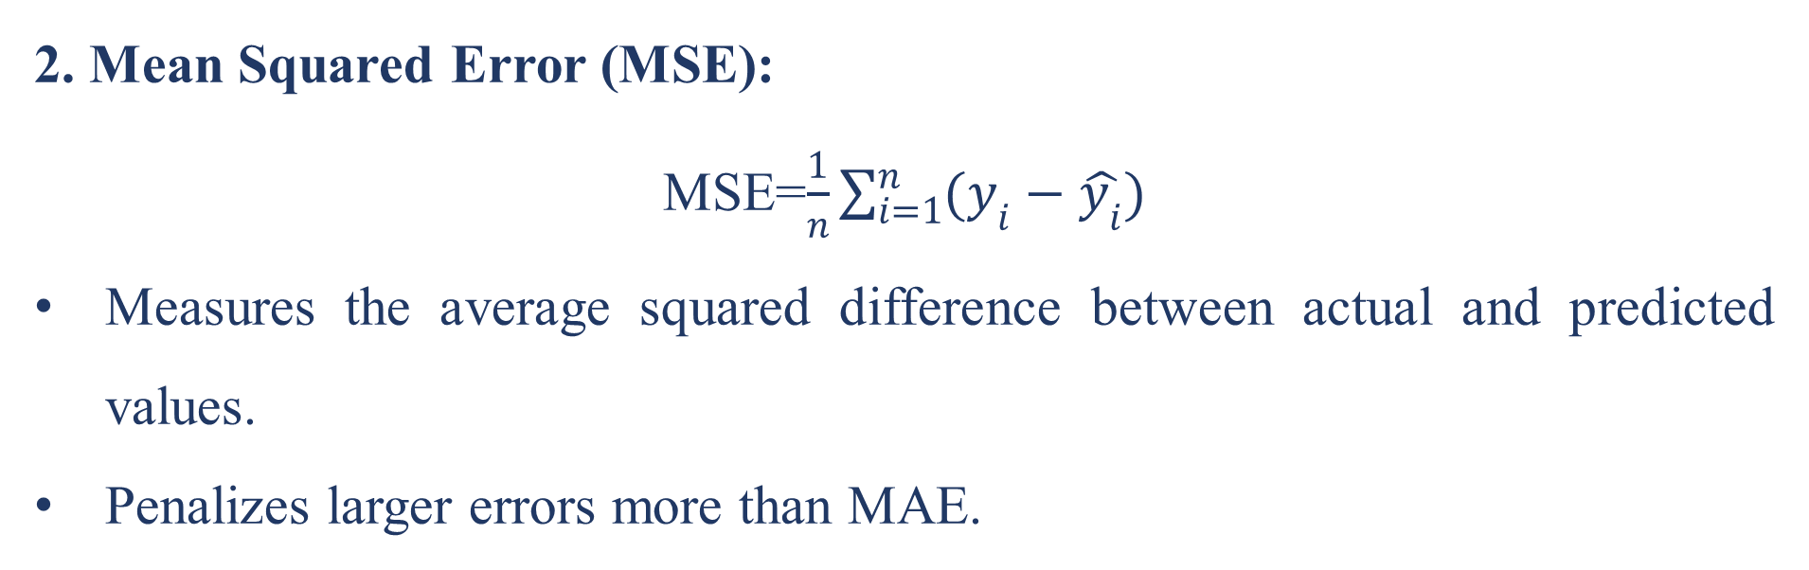
CLASS 41 CD-404 REGRESSION AND ITS TYPES UNIT 4
2. Mean Squared Error (MSE):
MSE=$\frac{1}{n}\sum_{i=1}^{n}{(y_{i}−\hat{y_{i}})}$
Measures the average squared difference between actual and predicted values.
Penalizes larger errors more than MAE.
Prof. Vineeta Shrivastava
Assistant Professor
Department of Computer Science & Engineering
LNCT-E, Bhopal
Lakshmi Narain College of Technology Excellence, Bhopal

Slide 48

CLASS 41 CD-404 REGRESSION AND ITS TYPES UNIT 4
3. Root Mean Squared Error (RMSE)
$RMSE=\sqrt{{\frac{1}{n}\sum_{i=1}^{n}{(y_{i}−\hat{y_{i}})}}^{2}}$
The square root of MSE, providing an error metric in the same units as the target variable.
Sensitive to outliers due to the squaring of errors
Prof. Vineeta Shrivastava
Assistant Professor
Department of Computer Science & Engineering
LNCT-E, Bhopal
Lakshmi Narain College of Technology Excellence, Bhopal

Slide 49

CLASS 41 CD-404 REGRESSION AND ITS TYPES UNIT 4
For Classification Models
Accuracy:
$$\text{Accurac}y=\frac{\text{Total} \text{Number} \text{of} \text{Predictions}}{\text{Number} \text{of} \text{Correct} \text{Predictions}}$$
The ratio of correctly predicted instances to the total instances.
Suitable for balanced datasets
Prof. Vineeta Shrivastava
Assistant Professor
Department of Computer Science & Engineering
LNCT-E, Bhopal
Lakshmi Narain College of Technology Excellence, Bhopal

Slide 50

CLASS 41 CD-404 REGRESSION AND ITS TYPES UNIT 4
Precision:
$\text{Precision}=\frac{\text{True} \text{Positives}\text{ (}\text{TP})}{\text{False} \text{Positives}\text{ (}\text{FP}\text{)}\text{True} \text{Positives}\text{ (}\text{TP}\text{) }}$
The ratio of correctly predicted positive observations to the total predicted positives.
Indicates how many selected items are relevant.
Prof. Vineeta Shrivastava
Assistant Professor
Department of Computer Science & Engineering
LNCT-E, Bhopal
Lakshmi Narain College of Technology Excellence, Bhopal

Slide 51
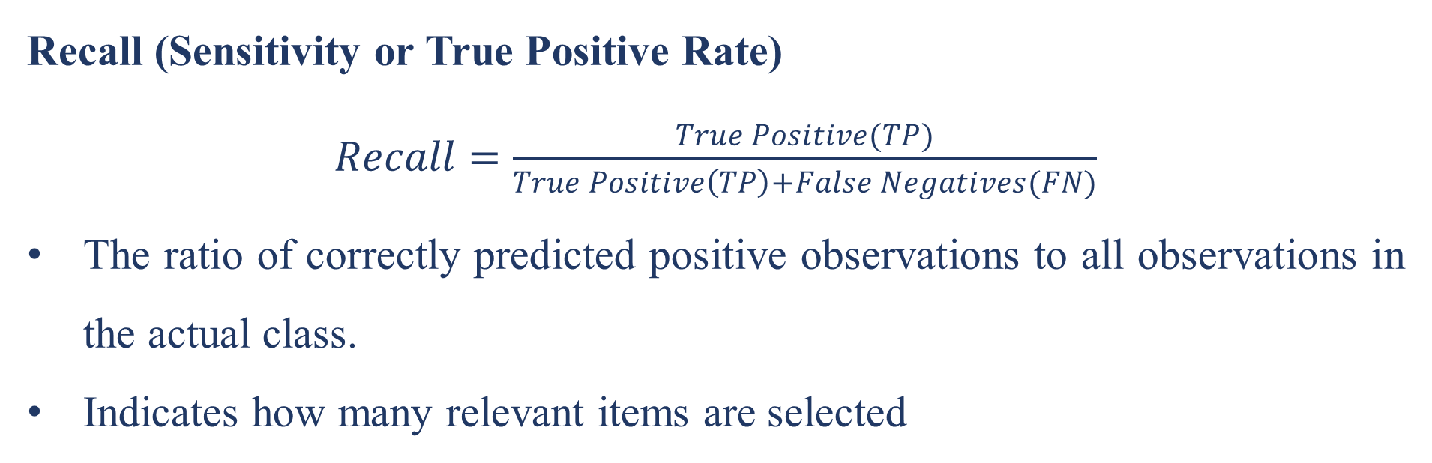
CLASS 41 CD-404 REGRESSION AND ITS TYPES UNIT 4
Recall (Sensitivity or True Positive Rate)
$Recall=\frac{True Positive(TP)}{True Positive\left(TP\right)+False Negatives(FN)}$
The ratio of correctly predicted positive observations to all observations in the actual class.
Indicates how many relevant items are selected
Prof. Vineeta Shrivastava
Assistant Professor
Department of Computer Science & Engineering
LNCT-E, Bhopal
Lakshmi Narain College of Technology Excellence, Bhopal

Slide 52

CLASS 41 CD-404 REGRESSION AND ITS TYPES UNIT 4
F1 Score
$$FI score=2∗\frac{\text{Precision}\text{×}\text{Recall}\text{​}}{\text{Precision}\text{+}\text{Recall}\text{​}}$$
The harmonic mean of precision and recall.
Useful for imbalanced datasets as it balances the trade-off between precision and recall.
Prof. Vineeta Shrivastava
Assistant Professor
Department of Computer Science & Engineering
LNCT-E, Bhopal
Lakshmi Narain College of Technology Excellence, Bhopal

Slide 53
CLASS 41 CD-404 REGRESSION AND ITS TYPES UNIT 4
Prediction and Decision Making
Prediction involves using statistical or machine learning models to estimate unknown outcomes based on input data.
Prediction in machine learning refers to the process of using a trained model to make predictions or infer unknown values based on input data.
This is a fundamental aspect of supervised learning, where the model learns patterns and relationships from labeled training data and then applies that knowledge to make predictions on new, unseen data.
Prof. Vineeta Shrivastava
Assistant Professor
Department of Computer Science & Engineering
LNCT-E, Bhopal
Lakshmi Narain College of Technology Excellence, Bhopal

Slide 54
CLASS 41 CD-404 REGRESSION AND ITS TYPES UNIT 4
Decision making in machine learning models refers to the process by which the model selects an outcome or takes action based on input data.
This process varies depending on the type of machine learning problem (classification, regression, reinforcement learning, etc.) and the specific algorithm or model being used.
Prof. Vineeta Shrivastava
Assistant Professor
Department of Computer Science & Engineering
LNCT-E, Bhopal
Lakshmi Narain College of Technology Excellence, Bhopal

Slide 55
CLASS 41 CD-404 REGRESSION AND ITS TYPES UNIT 4
General overview of decision making in different types of machine learning models.
Binary Classification: In binary classification, the model makes a decision between two classes or categories (e.g., spam vs. non-spam emails).
Multiclass Classification: For multiclass classification (more than two classes), the model selects the class with the highest predicted probability or confidence score
Prof. Vineeta Shrivastava
Assistant Professor
Department of Computer Science & Engineering
LNCT-E, Bhopal
Lakshmi Narain College of Technology Excellence, Bhopal

Slide 56
CLASS 41 CD-404 REGRESSION AND ITS TYPES UNIT 4
THANKYOU
Prof. Vineeta Shrivastava
Assistant Professor
Department of Computer Science & Engineering
LNCT-E, Bhopal
Lakshmi Narain College of Technology Excellence, Bhopal

